Slide 1
2019 Awards Program
Rodney J. Simmons, Ph.D., CSP
Incoming Director for Education and Professional Development Acting Operating Vice President for Awards

Slide 2
2019 Awards Program – What’s New
No change

Slide 3
2019 Challenge – Finding Nominees
Colleagues
Previous Applicants
Mentees
Organizations
Goal: Every Chapter Nominates an Individual or Group
Notes:
2017 there were contested nominations!

Slide 4
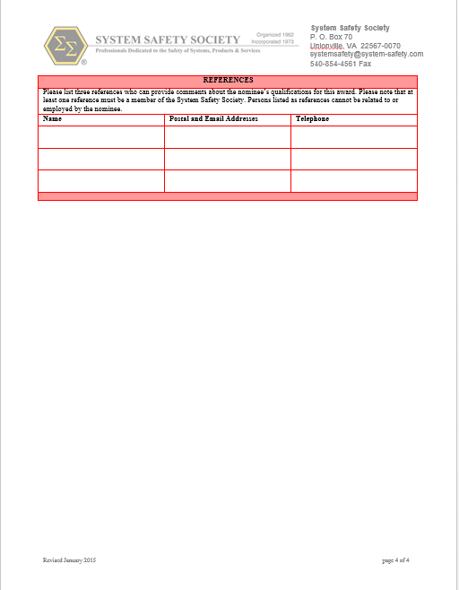
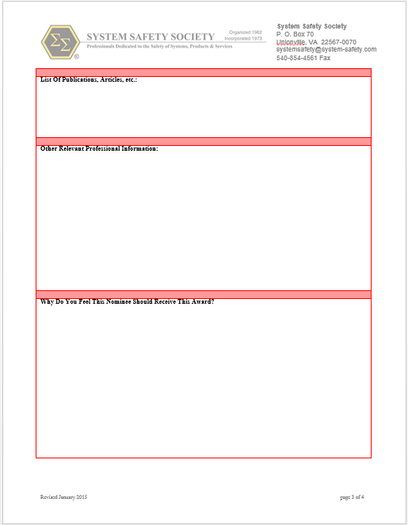
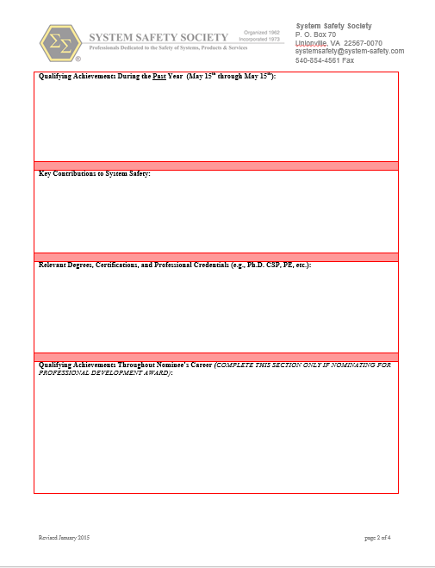
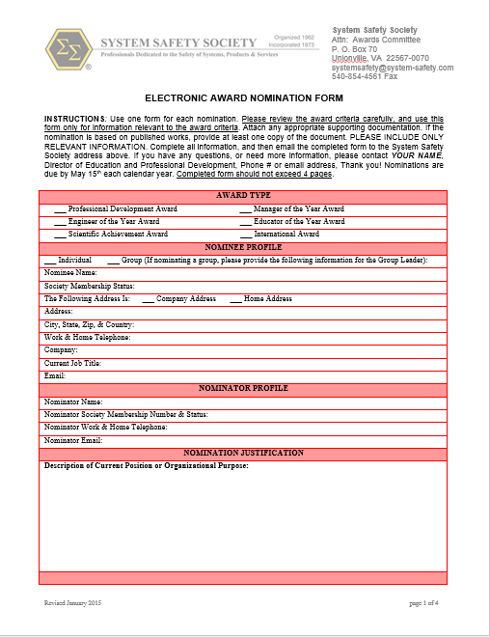
One Application Form
Covers Period from May 15 2018- May 14, 2019
2019 Award Categories
Engineer of the Year
Manager of the Year
Educator of the Year
Scientific Research and Development Award
Professional Development Award
International Award

Slide 5
Awards Selection Eligibility*
AWARD | ELIGIBLE RECIPIENTS
Professional Development Award | Fellow and Senior Society members only.
Manager of the Year | Any System Safety Society member.
Engineer of the Year | Any System Safety Society member.
Educator of the Year | Any System Safety Society member involved in education.
Scientific Achievement Award | Any individual, group, or organization.
International Award | Any Society member, group, or organization.
*Chapter of the Year and the President’s Award are separate nomination criteria; please see http://www.system-safety.org/development/societyawards.php

Slide 6
2019 Awards Schedule
Date | Activity
May 15 | Awards Submission Period Begins
May 24 | Call For Award Judges (Nominees may not judge awards)
June 15 | Award Applications Due
June 1-20 | Award Application Evaluation
July 1 | Letters to Nominators and Applicants
August 101 | Awards Distributed at 37th System Safety Society Conference Norfolk, VA

Slide 7
Preparing Award Nomination Application
Please read instructions in the “Annual Awards, Cycle and Nomination Criteria Document”
Consider the award and criteria when nominating for individuals or groups
Follow the nomination procedures
Use only one application per nomination (for example if you are nominating a candidate for more than one award, then complete an application for each award)
Verify contact information for nominator and nominee profiles for ensuring feedback on applications

Slide 8
Preparing Award Nomination Application
Complete every section of the application in accordance to the award criteria
Provide supplemental information as appropriate
Published works can be submitted as an attachment to the nomination form
Provide up to 3 references; one must be a System Safety Society member (not related to nor employed by the nominee)
Email completed awards form directly to systemsafety@system-safety.org

Slide 9
Awards Committee Judging
Call for awards judges will start in April
Judge Qualification Criteria –
Availability to review and grade applications between June 1- 20
Cannot be a nominee for an award
Orientation teleconference available

Slide 10
Awards Program Contact Information
Linda M S Thomas, Acting OVP Awards Program
linda.m.thomas@boeing.com
(206) 914-4751
Please do not mail applications to this address!

